Slide 1

Database Design and Diagramming with Dia
Your Instructor: Judy Richardson

Slide 2
Task 1: Exploring Dia
Database Design and Diagramming with Dia

Slide 3
For this Course:
Dia:
Diagramming Software
Loaded on your virtual desktop
Free for you to download on your own computer after this course

Slide 4
Dia Diagrams:
Made up of “objects”
Shapes
Lines
Text
Images

Slide 5
Task 2: Database Design
Database Design and Diagramming with Dia

Slide 6
Requirements Analysis:
What is the scope (how big is this thing going to be?)
Who are the players?
What do they hope to use the database for?
What are they doing right now?

Slide 7
Requirements Analysis:
Collect information about:
Entities and attributes
Processes in place
New processes needed

Slide 8
Database Design:
Collect information about:
Entities and attributes
Processes in place
New processes needed

Slide 9
Database Design:
ERD (Entity Relationship Diagram)
Logical Design
Relational Model Diagram
Converts the logical design into a physical design

Slide 10
Task 3: Meet the ERD
Database Design and Diagramming with Dia

Slide 11
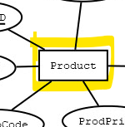
ERD Components:
Each rectangle represents an ENTITY
A person, place, thing, or event important enough to have data stored to describe it

Slide 12
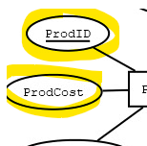
ERD Components:
Each oval represents an ATTRIBUTE
A characteristic or piece of data that describes the Entity it’s connected to

Slide 13
About those attributes:
Each attribute has a single value for each instance of the Product.
Each individual product can have only product ID, one cost, one description, one price, one fabric code.

Slide 14
About those attributes:
Each entity instance must be identifiable.
Each student is identified by his or her studentID.

Slide 15
ERD Components:
The attribute that’s underlined is the primary key of the entity it is connected to.

Slide 16
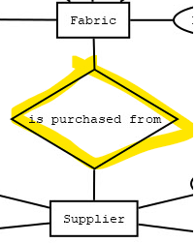
ERD Components:
Each diamond represents a RELATIONSHIP
A logical description of the interaction between two entities

Slide 17
Task 4: Find the Good Stuff
Database Design and Diagramming with Dia

Slide 18
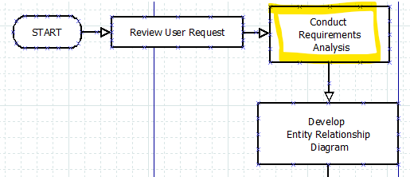
Database Design Steps:

Slide 19
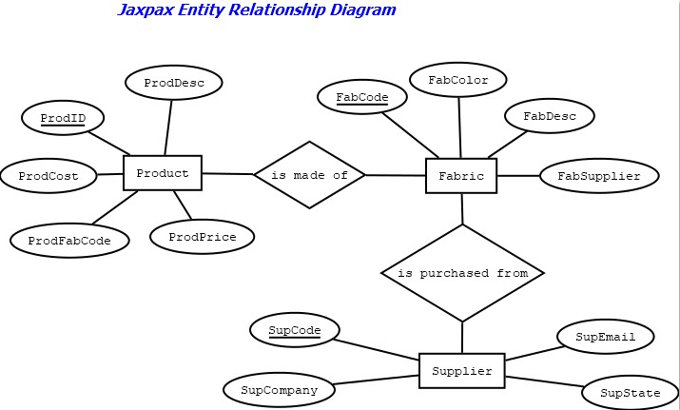
Jaxpax ERD (so far…):

Slide 20
Identify:
ENTITIES
Person, place, thing, activity, event, etc.
ATTRIBUTES
Characteristics or descriptors of entities

Slide 21
Transcript:
“We use a really large spreadsheet currently to track which products our customers have ordered, when each order was placed and who we used to ship the products.”

Slide 22
Task 5: Entities and Attributes in the ERD
Database Design and Diagramming with Dia

Slide 23
Task 6: Relationships Complete the ERD
Database Design and Diagramming with Dia

Slide 24
ERD Components:
Each diamond represents a RELATIONSHIP
A logical description of the interaction between two entities

Slide 25
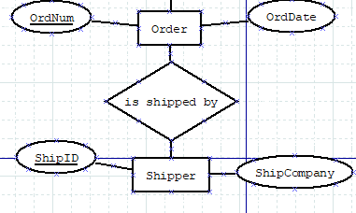
Add the Relationship:
An order IS SHIPPED BY a shipper.

Slide 26
Customers and Products:
A customer purchases a product.
How?
By placing an order for the product!

Slide 27
Cardinality:
How many times does an instance of one entity relate to another?
1:1
1:n
N:n

Slide 28
Cardinality:
Can a customer place many (more than one) orders? YES
One customer can place many orders
Can and order be placed by many customers? NO

Slide 29
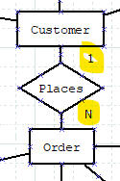
Cardinality in the ERD:
Customer and Order have a one-to-many relationship.
Each customer could place zero, one, or many orders.
Each order was placed by one specific customer.

Slide 30
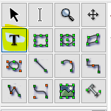
Cardinality in the ERD:
Add the 1s and Ns with the Text Tool

Slide 31

Congratulations on completing
Database Design and Diagramming with Dia

